Slide 1
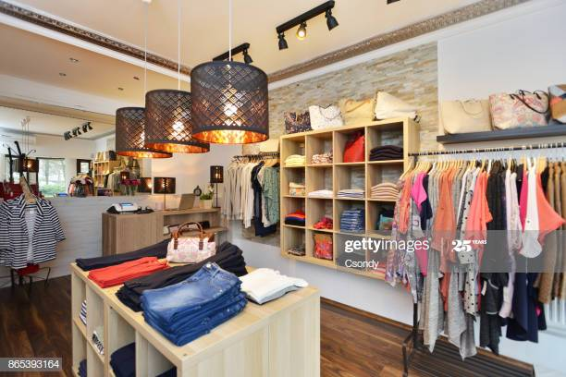
Data Report on Women’s Clothing Review
By : Obed Ayettey and Anita Blege

Slide 2
Hypothesis and Aim of the Analysis
HYPOTHESIS : Buyers who leave a higher rating (>3) are more likely to recommend the product they purchased.
AIM : To confirm our hypothesis or find new insights using data exploration.
Customers show their satisfaction or dissatisfaction through reviews
Reviews, ratings and recommendations provide insight for marketing, sales and revenue.

Slide 3
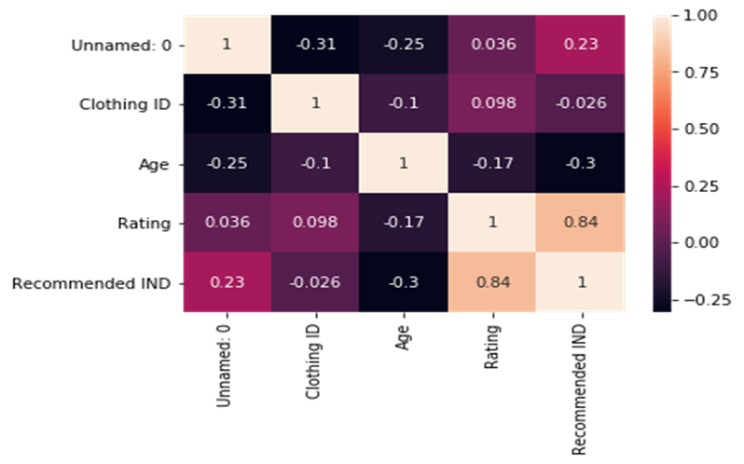
Fig. 1: A heat map showing the correlation between Clothing ID, Age, Rating and Recommendation.

Slide 4
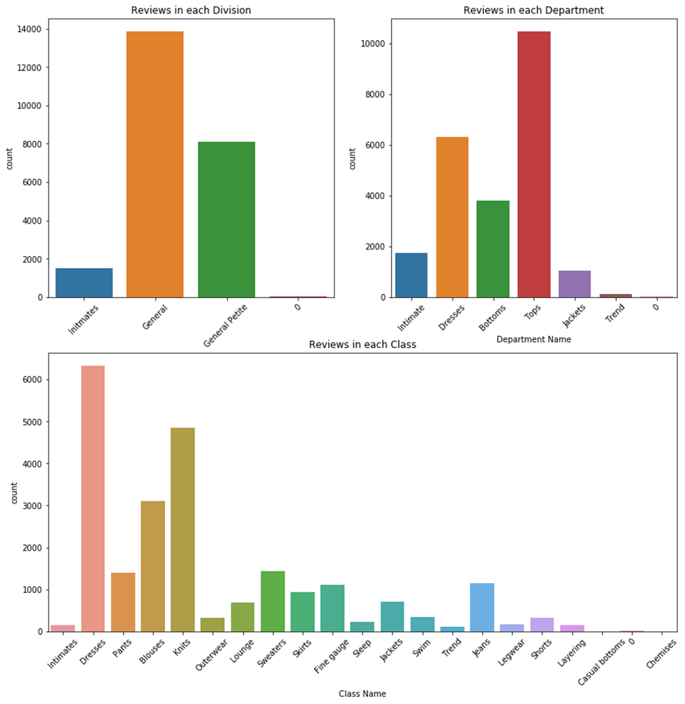
Fig. 3: A count plot showing the total count of reviews in each division, department and class.

Slide 5
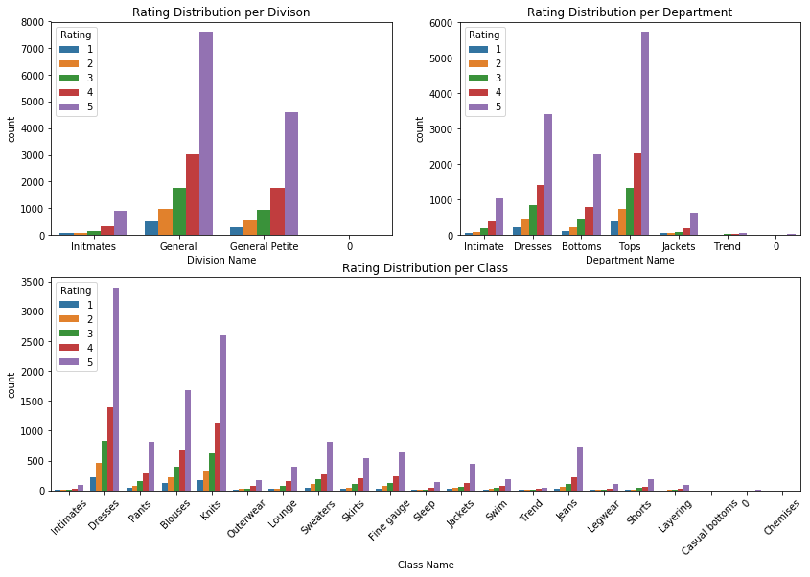
Fig. 4: A count plot showing the distribution of ratings per division, department and class.

Slide 6
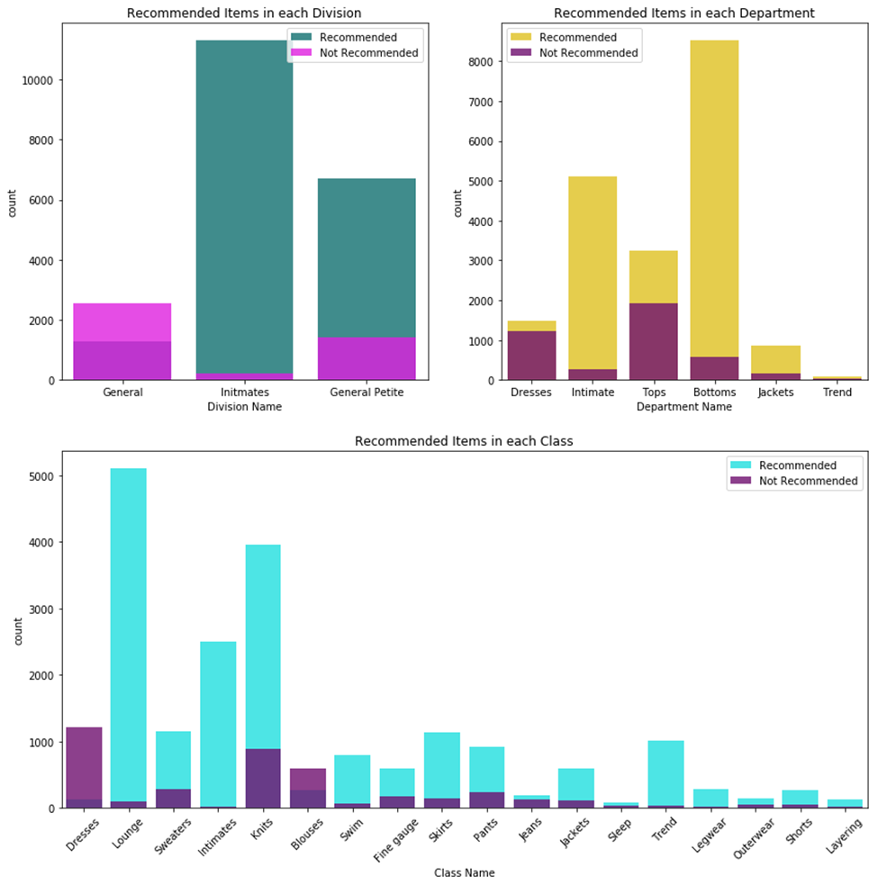
Fig. 5: A count plot showing the distribution of recommendations per division, department and class.

Slide 7
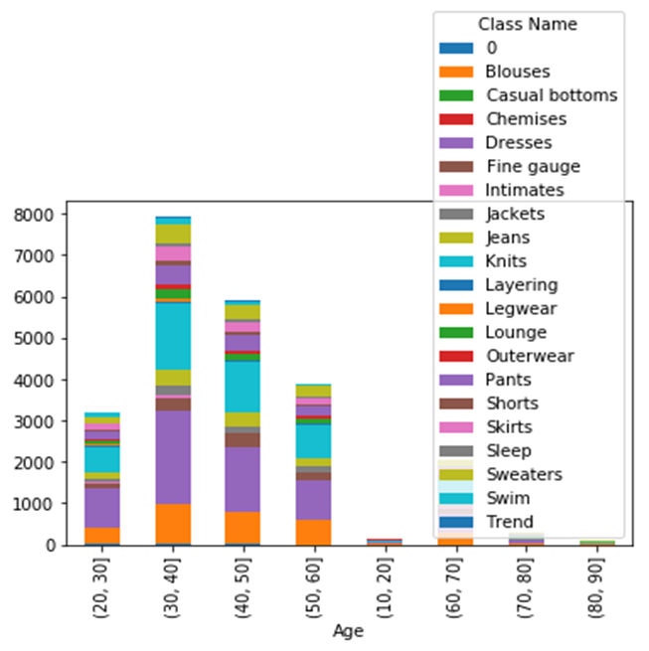
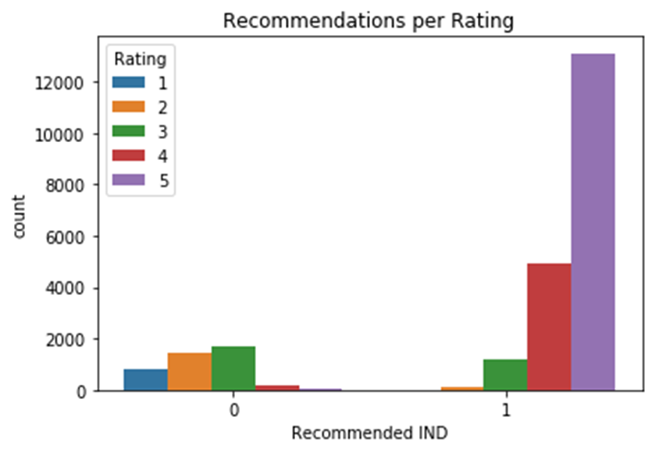
Fig 2 : Graphs showing Recommendations against Ratings; and Age against Class Name

Slide 8
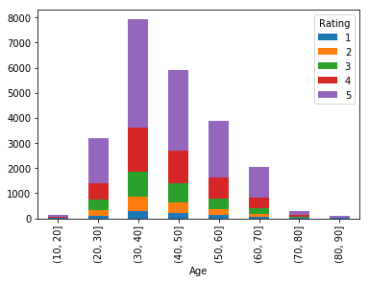
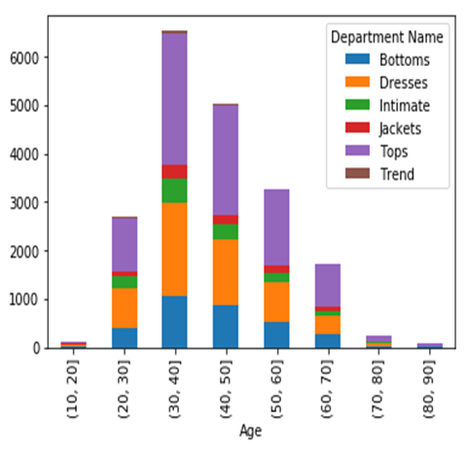
Fig 6 : Graphs showing Age groups against Rating and Department Name

Slide 9
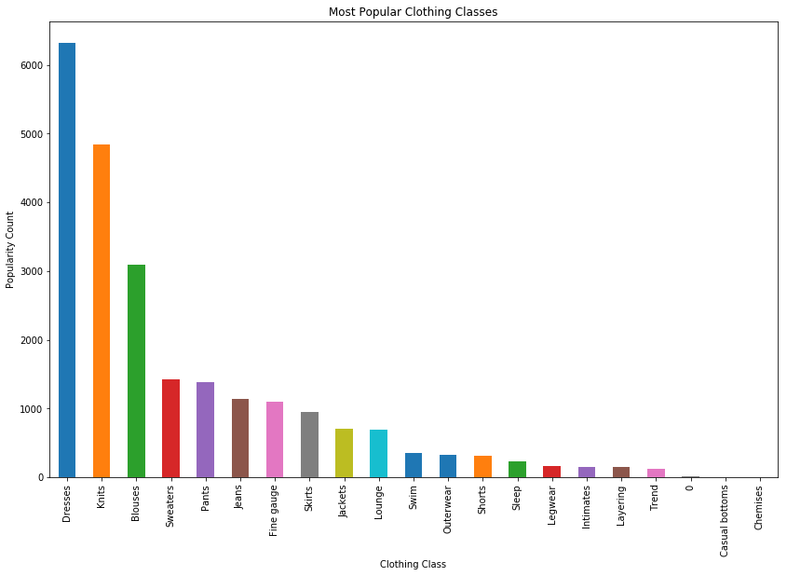
Fig 9 : A graph showing the Most popular Clothing Classes

Slide 10
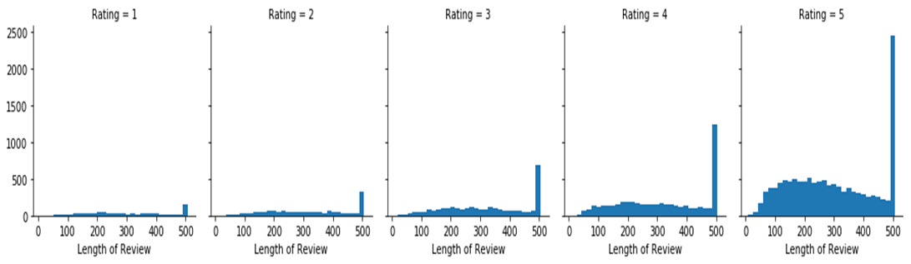
Fig 10 : Histograms showing the correlation between Length of Review and Rating

Slide 11
Summary of Insights
The hypothesis was supported by the data analysis. Ratings and review length were highly correlated with customer recommendations.
Certain factors like age, department or type of clothing and length of reviews directly influenced ratings and recommendations.
Some items had many reviews and high ratings but were not recommended by customers, while others were recommended but were not rated by their buyers.
Certain clothing types, regardless of ratings and recommendations, were popular across all ages.

Slide 12
Thank you !

